Slide 1

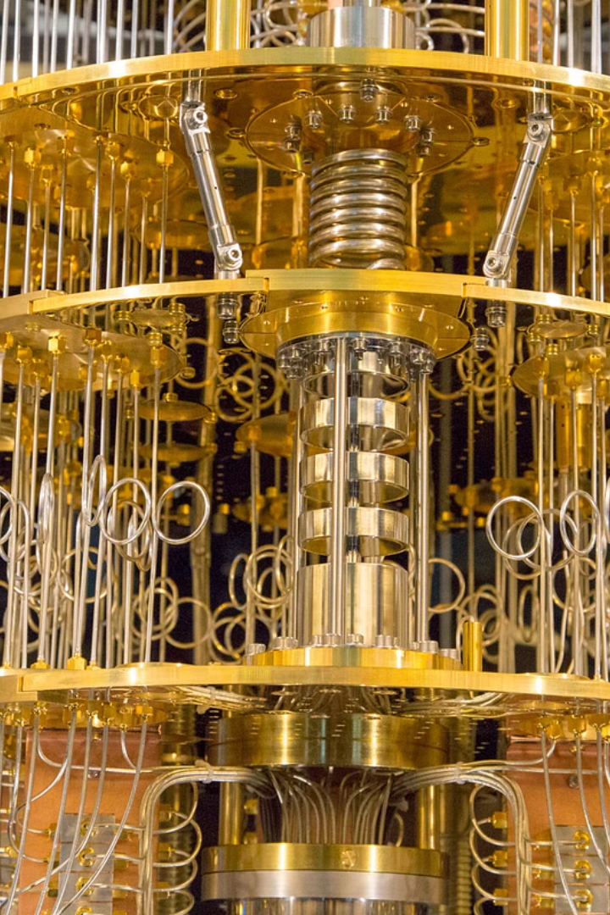


Introduction to Quantum Computers
Quantum computers are a type of computing technology that utilizes the laws of quantum mechanics. They have the potential to solve complex problems that are currently impossible for classical computers to handle.
by Natnael Sisay

Slide 2
IBM Q System One
1
Overview
IBM Q System One is a fully integrated quantum computer designed for stability and reliability.
2
Recent Developments
It has been deployed commercially and has a growing user base within the scientific community.
3
Applications
It is being used for research in quantum algorithms and applications, quantum chemistry, and optimization problems.

Slide 3
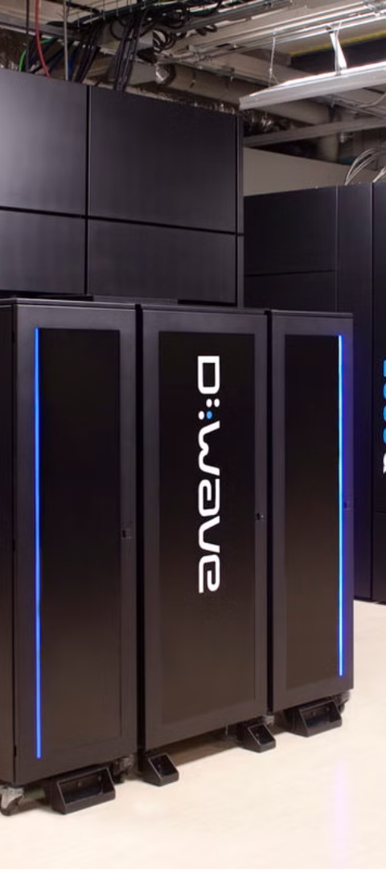
D-Wave Systems
1
Quantum Annealing
2
Usage
D-Wave specializes in quantum annealing-based quantum computers, focusing on optimization problems.
Its systems have been used in areas such as financial modeling, bioinformatics, and fault detection.
3
Performance
D-Wave's quantum computers have shown promise in solving specific problems faster than classical computers.

Slide 4



Rigetti Computing
Quantum Processors
Quantum Cloud Services
Focuses on building hybrid quantum-classical computing systems with high-fidelity quantum processors.
Offers cloud access to quantum systems, fostering a growing community of quantum developers.

Slide 5
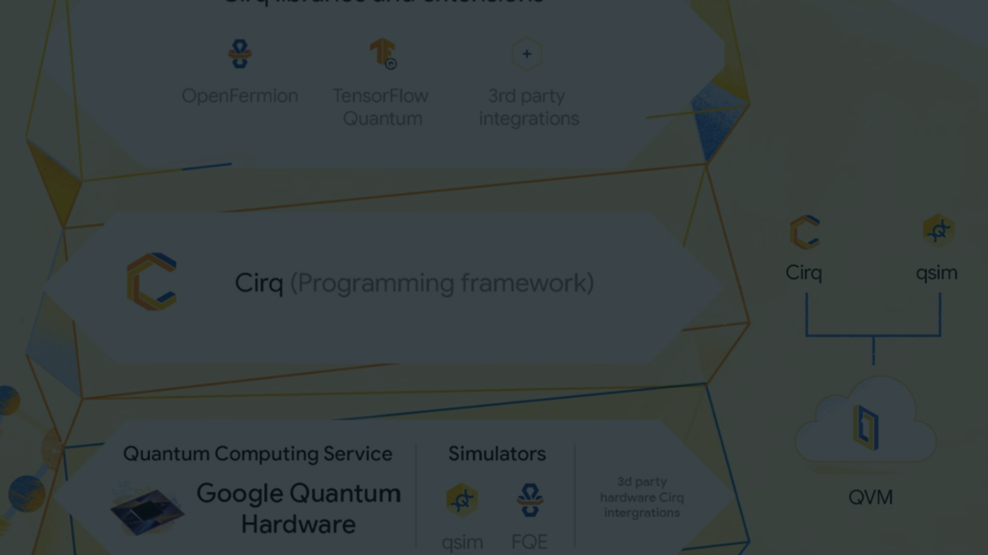
Google Quantum AI
Quantum Supremacy
Quantum Algorithms
Partnerships
Google's progress towards achieving quantum supremacy has demonstrated its commitment to quantum computing research.
The company is actively developing quantum algorithms for practical use cases in various industries.
Collaborations with academic institutions and research labs have propelled advancements in quantum computing.

Slide 6
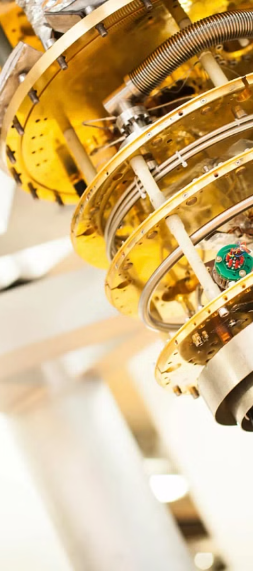



Intel Quantum Computing
Research Focus
Intel is focusing on building its quantum computing capabilities and expanding its research efforts.
Industry Collaboration
It has partnerships with quantum research experts and academic communities for knowledge exchange.
Investment
Intel's significant investments in quantum computing reflect its confidence in the technology's future potential.

Slide 7
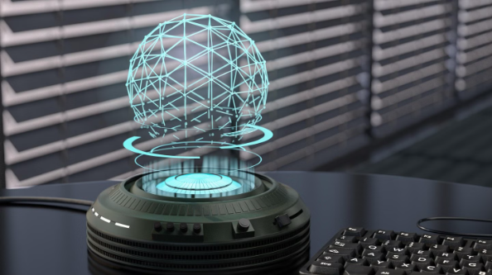
Microsoft Quantum Development Kit
Holographic Quantum Computing
Software Ecosystem
Microsoft's research into holographic quantum computing could revolutionize information processing.
Developing a rich software ecosystem to enable quantum development and research.

Slide 8
Future Outlook and Advancements
Quantum Volume
Increasing the quantum volume of systems to handle larger and more complex calculations.
Interdisciplinary Applications
Exploring interdisciplinary applications in fields such as materials science, finance, cryptography, and healthcare.

